Slide 1
AJAX
Asynchronous JavaScript And XML
Notes:
https://www.youtube.com/watch?v=IyCnbyWZkRU
https://www.youtube.com/watch?v=q4zOAFURAsU&list=PL7K_NRckWQJb_dzXTojmuVATo0NWIUhY7

Slide 2
Introduction
AJAX is an acronym for Asynchronous JavaScript and XML.
AJAX is not a programming language.
It is a group of inter-related technologies like JavaScript, DOM, XML, HTML, CSS etc.
AJAX allows you to send and receive data asynchronously without reloading the web page. So it is fast.
AJAX allows you to send only important information to the server not the entire page.
So only valuable data from the client side is routed to the server side. It makes your application interactive and faster.

Slide 3
AJAX is a new technique for creating better, faster, and more interactive web applications with the help of XML, HTML, CSS, and Java Script.
AJAX is not a programming language.
AJAX applications might use XML to transport data, but it is equally common to transport data as plain text or JSON text.
AJAX allows web pages to be updated asynchronously by exchanging data with a web server behind the scenes. This means that it is possible to update parts of a web page, without reloading the whole page.

Slide 4
Features of Ajax
User Friendly : easy to use or understand.
It make web page faster.
Increase the Performance of web page.
Rich and, responsive user interfaces
Reduced consumption of server resources
No need to reload the whole page only some part of page is reloaded which is required to reload.
Using ajax, develop faster and more interactive web applications.
Not require to completely reload page due to this, server use less bandwidth.
Notes:
Bandwidth is the capacity of a wired or wireless network communications link to transmit the maximum amount of data from one point to another over a computer network or internet connection in a given amount of time -- usually one second.

Slide 5
Where it is used?
There are too many web applications running on the web that are using ajax technology like;
Gmail
Facebook
Twitter
Google
Youtube

Slide 6
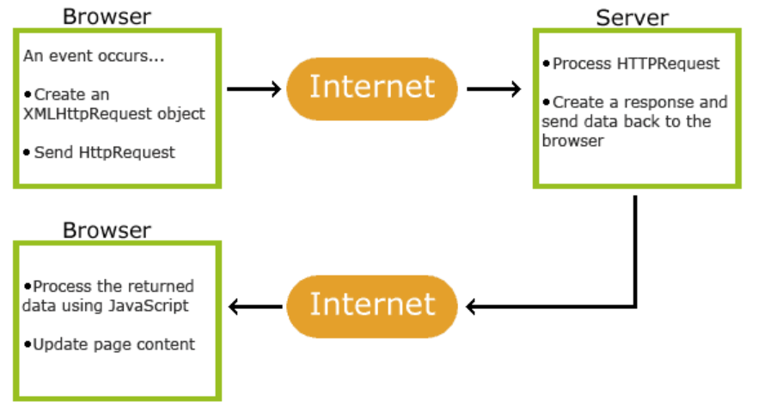
How AJAX Works

Slide 7
Work flow
An event occurs in a web page (the page is loaded, a button is clicked)
An XMLHttpRequest object is created by JavaScript
The XMLHttpRequest object sends a request to a web server
The server processes the request
The server sends a response back to the web page
The response is read by JavaScript
Proper action (like page update) is performed by JavaScript

Slide 8
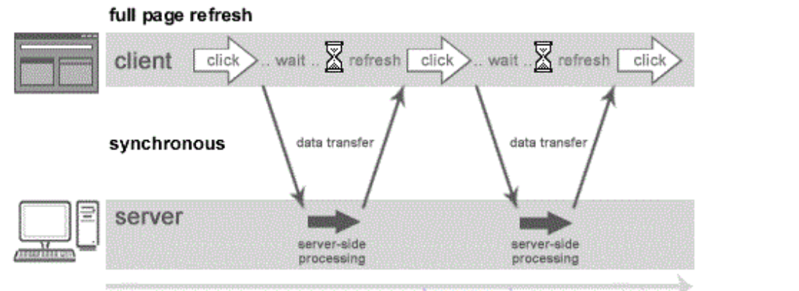
Synchronous (Classic Web-Application Model)
A synchronous request blocks the client until operation completes i.e. browser is unresponsive. In such case, JavaScript engine of the browser is blocked.

Slide 9
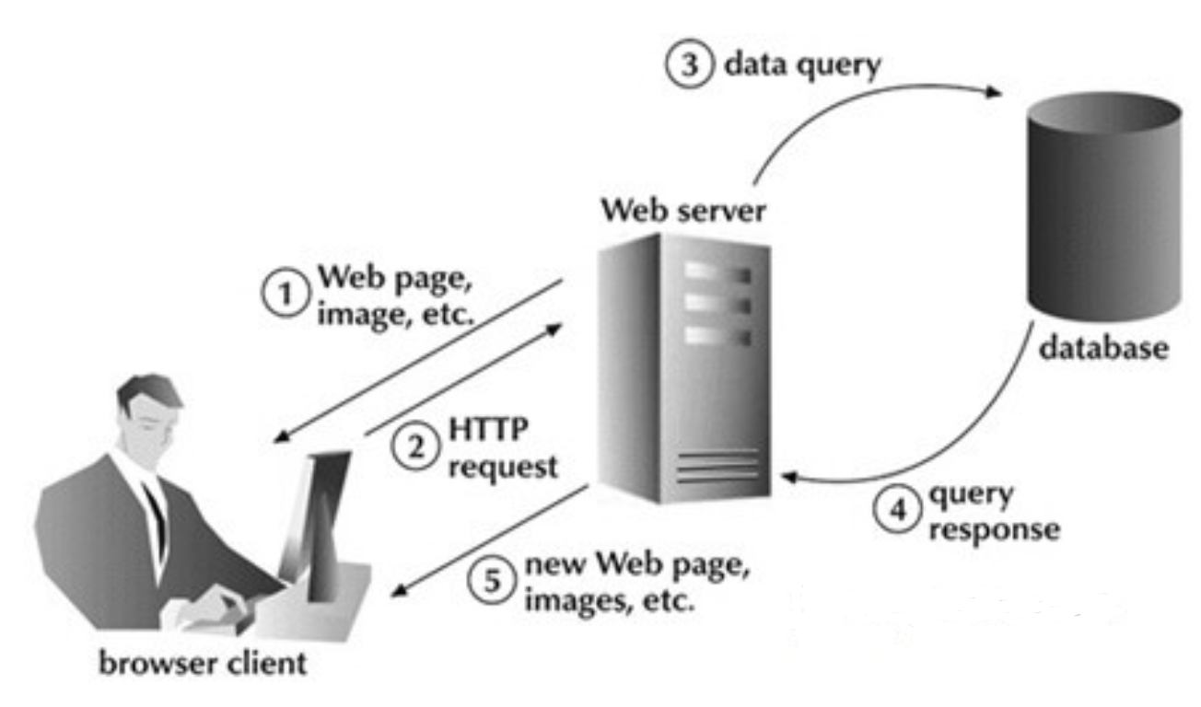

Slide 10
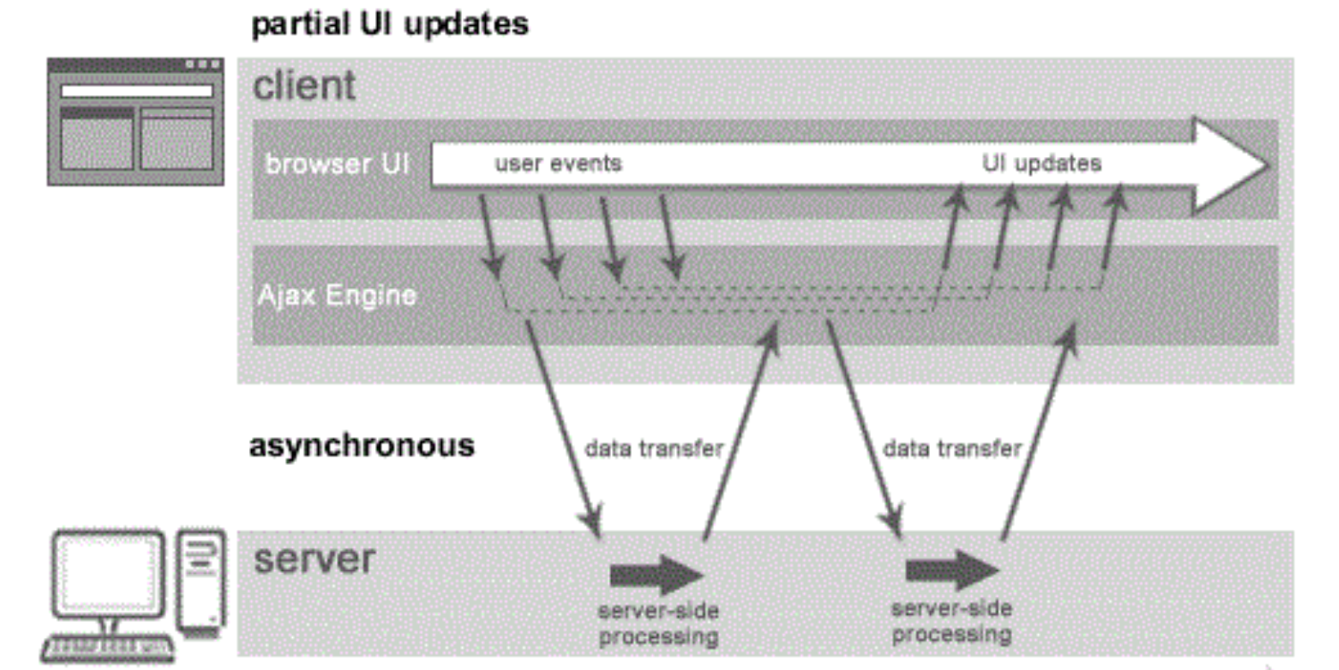
Asynchronous (AJAX Web-Application Model)
An asynchronous request doesn’t block the client i.e. browser is responsive. At that time, user can perform another operations also. In such case, JavaScript engine of the browser is not blocked.
Notes:
https://www.phptpoint.com/create-image-gallery-in-php/

Slide 11
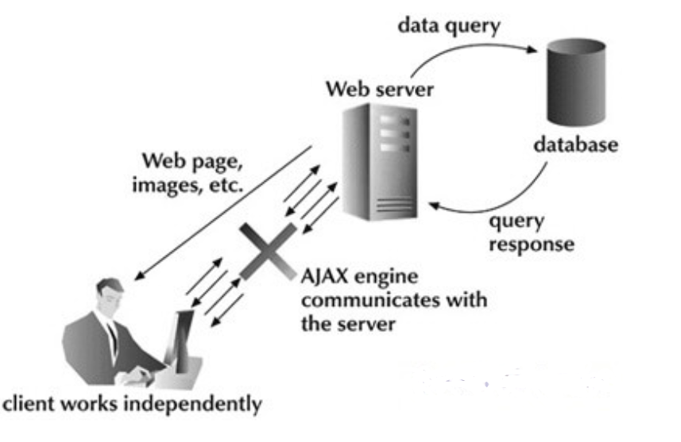

Slide 12
AJAX Technologies
Ajax is not a technology but group of inter-related technologies. AJAX technologies includes:
HTML and CSS
DOM
XML or JSON
XMLHttpRequest
JavaScript

Slide 13
AJAX Technologies
HTML and CSS
These technologies are used for displaying content and style. It is mainly used for presentation.
DOM
It is used for dynamic display and interaction with data.
XML or JSON
For carrying data to and from server. JSON (Javascript Object Notation) is like XML but short and faster than XML.
XMLHttpRequest
For asynchronous communication between client and server.
JavaScript
It is used to bring above technologies together.
Independently, it is used mainly for client-side validation.

Slide 14
Ajax Works as Follow
Create XMLHttpRequest Object
Send Request
Get Response
Events
Callback Function

Slide 15
XMLHttpRequest
The XMLHttpRequest object is used to exchange data with a server behind the scenes. This means that it is possible to update parts of a web page, without reloading the whole page.
An object of XMLHttpRequest is used for asynchronous communication between client and server.
It performs following operations:
Sends data from the client in the background
Receives the data from the server
Updates the webpage without reloading it.

Slide 16
Create an XMLHttpRequest Object
Syntax for creating an XMLHttpRequest object:
Syntax
variable=new XMLHttpRequest();

Slide 17
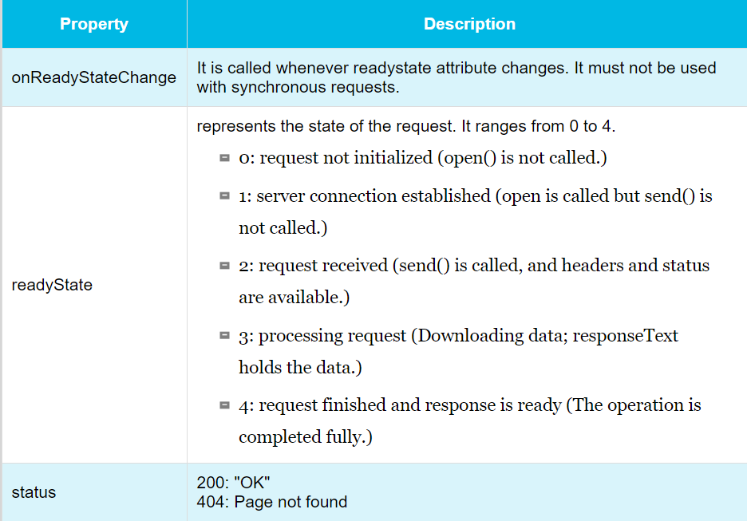
Three important properties of the XMLHttpRequest object:

Slide 18
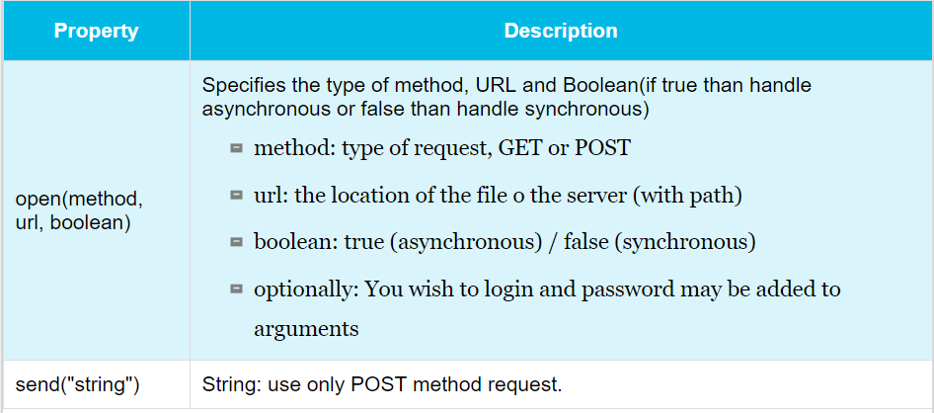
Send a Request to Server using Ajax
XMLHttpRequest Object, following methods are allow to interact with the server.

Slide 19
GET or POST Method
GET is simpler and faster than POST, so mostly use a GET.
However, always use POST requests when:
Sending a large amount of data to the server (POST has no size limitations).
Sending user input (which can contain unknown characters), POST is more robust and secure than GET.
Notes:
Robust : handling incorrect user input,
Thus, an operating system in which any individual application can fail
without disturbing the operating system or other applications can be said to be robust.

Slide 20
Post Method
Syntax
xmlhttp.open("POST", url, true) // xmlhttp is variable name xmlhttp.send(String)
GET Method
Syntax
xmlhttp.open("GET", url, true) // xmlhttp is variable name xmlhttp.send()

Slide 21
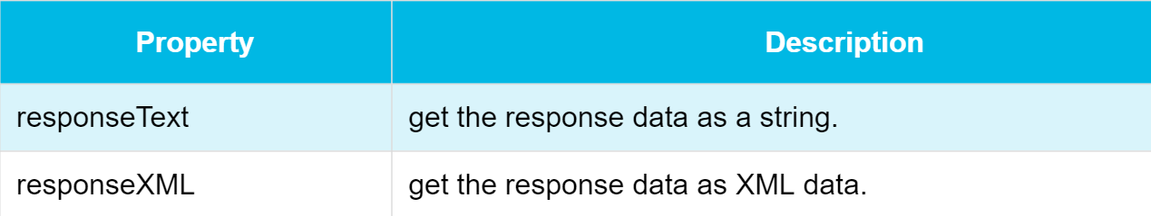
Get Server Response using Ajax
To get the response from a server, use the responseText or responseXML property of the XMLHttpRequest object.

Slide 22
The responseText Property
If the response from the server is not XML, use the responseText property.
The responseText property returns the response as a string, and you can use it accordingly
The responseXML Property
If the response from the server is XML, and you want to parse it as an XML object, use the responseXML property.

Slide 23
Ajax Events
The onreadystatechange event
When a request to a server is sent, some actions based on the response.
The onreadystatechange event is triggered every time the readyState changes.
The readyState property holds the status of the XMLHttpRequest.

Slide 24
Continue
In the onreadystatechange event, we specify what will happen when the server response is ready to be processed.
When readyState is 4 and status is 200, the response is ready:
Syntax
xmlhttp.onreadystatechange=function()
{
if (xmlhttp.readyState==4 && xmlhttp.status==200)
{ document.getElementById("myDiv").innerHTML=xmlhttp.responseText;
}
}

Slide 25
Callback Function in Ajax
A callback function is a function passed as a parameter to another function.
If you have more than one AJAX task on your website, you should create ONE standard function for creating the XMLHttpRequest object, and call this for each AJAX task.
The function call should contain the URL and what to do on onreadystatechange (which is probably different for each call):

Slide 26
Example of Callback Function in Ajax
function loadDoc(url, myFunction) {
var xhttp;
xhttp=new XMLHttpRequest();
xhttp.onreadystatechange = function() {
if (this.readyState == 4 && this.status == 200) {
myFunction(this);
}
};
xhttp.open("GET", url, true);
xhttp.send();
}
function myFunction(xhttp) {
document.getElementById("demo").innerHTML =
xhttp.responseText;

Slide 27
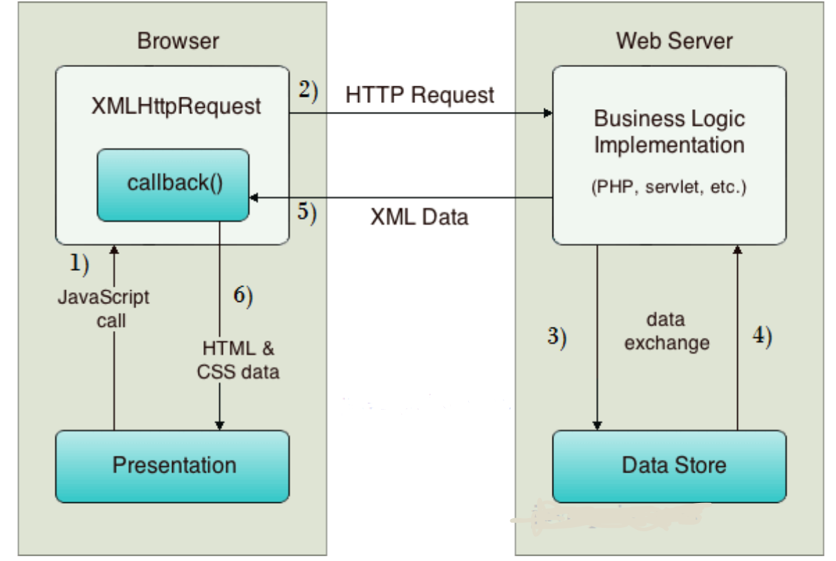
How AJAX works?
AJAX communicates with the server using XMLHttpRequest object.

Slide 28
Work FLow
User sends a request from the UI and a javascript call goes to XMLHttpRequest object.
HTTP Request is sent to the server by XMLHttpRequest object.
Server interacts with the database using JSP, PHP, Servlet, ASP.net etc.
Data is retrieved.
Server sends XML data or JSON data to the XMLHttpRequest callback function.
HTML and CSS data is displayed on the browser.

Slide 29
Example of Callback Function in Ajax
function myFunction()
{
loadXMLDoc("ajax_info.txt",function()
{
if (xmlhttp.readyState==4 && xmlhttp.status==200)
{ document.getElementById("myDiv").innerHTML=
xmlhttp.responseText;
}
});
}

Slide 30
function loadDoc(url, myFunction) {
var xhttp;
xhttp=new XMLHttpRequest();
xhttp.onreadystatechange = function() {
if (this.readyState == 4 && this.status == 200) {
myFunction(this);
}
};
xhttp.open("GET", url, true);
xhttp.send();
}
function myFunction(xhttp) {
document.getElementById("demo").innerHTML =
xhttp.responseText;

Slide 31
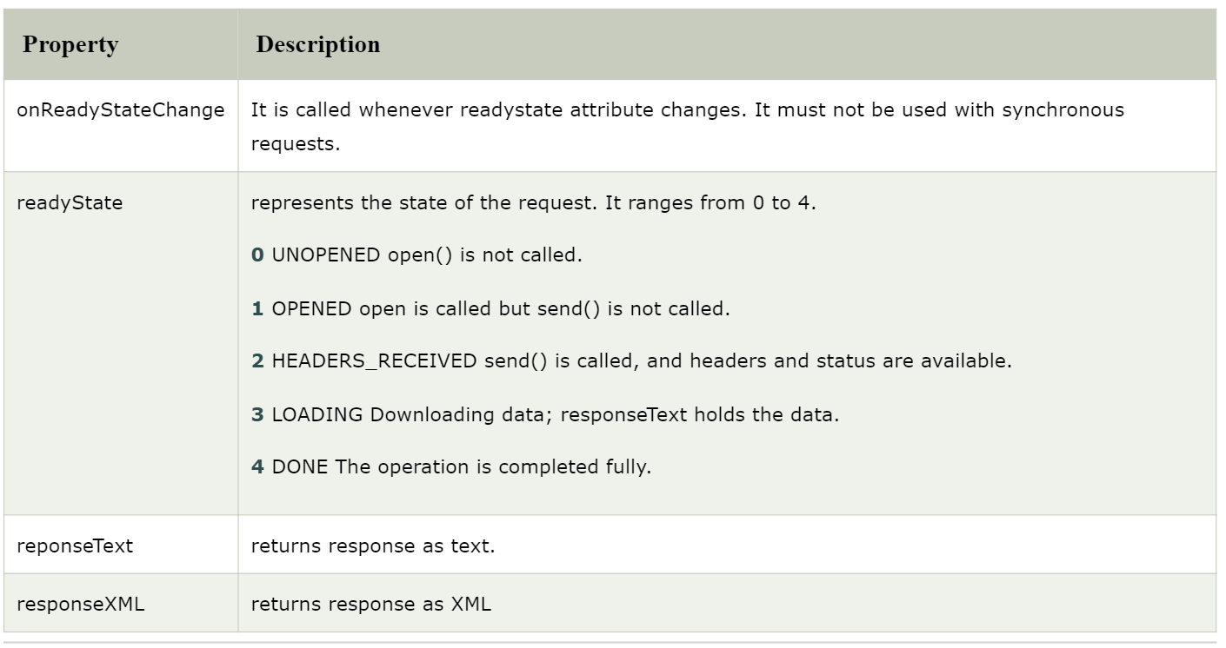
Properties of XMLHttpRequest object

Slide 32
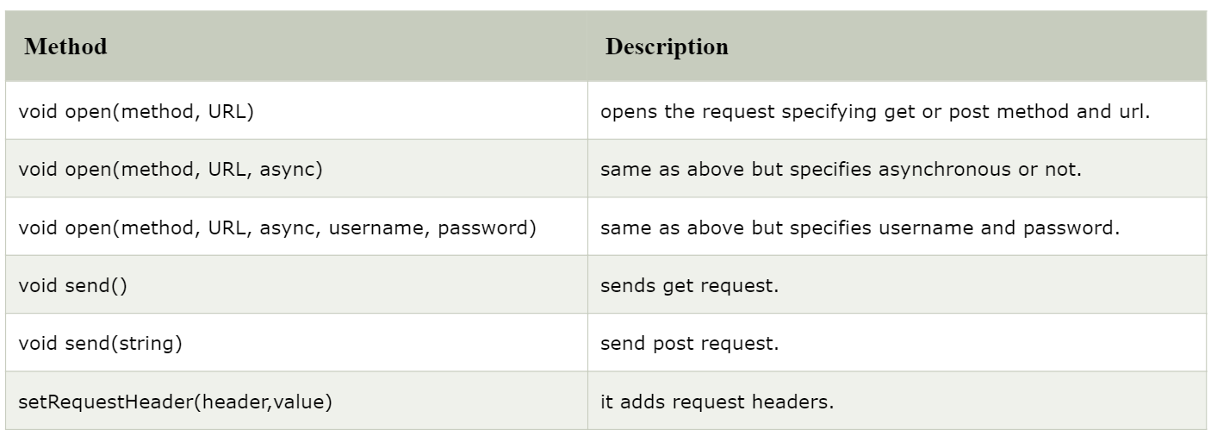
Methods of XMLHttpRequest object

Slide 33
Ajax jQuery Methods

Slide 34
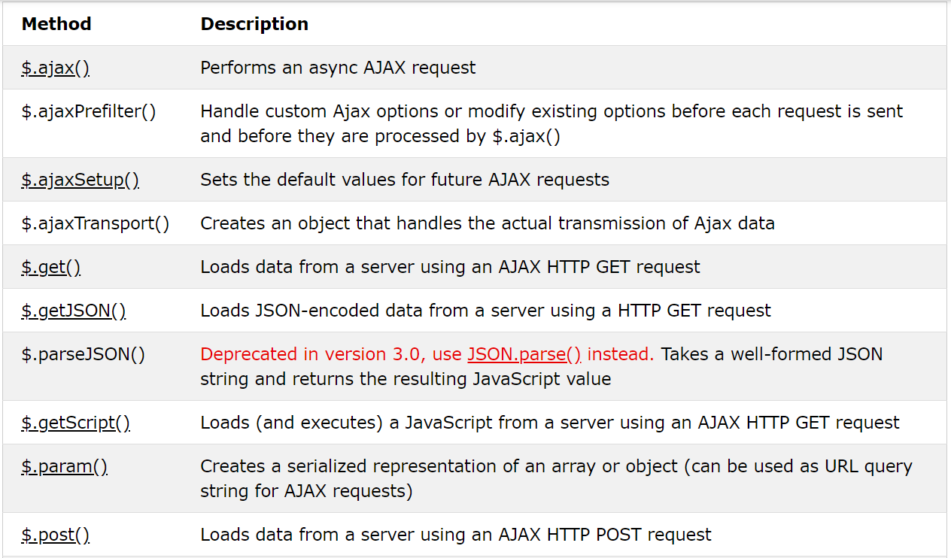

Slide 35
